Slide 1
EXCEL PROJECT
Project Title: Big Mart Sales Analysis
Objective: Derive valuable insights from Big Mart's sales data to enhance decision-making.
Slide 2: Dataset Overview
Dataset Name: Big Mart Sales Dataset
Dimensions: 11 columns, 1001 rows
Slide 3: Dataset Fields
Fields:
Item Identifier
Item Weight
Item Fat Content
Item Type
Item MRP
Outlet Identifier
Outlet Establishment Year
Outlet Size
Outlet Location Type
Outlet Type
Item Outlet Sales

Slide 2
QUESTIONS BASED ON DATASET
WHAT IS THE HIGHEST AND LOWEST SALES IN PARTICULAR YEAR?
WHICH ITEM TYPE HAS THE HIGHEST AND LOWEST SALES?
WHAT IS THE MAXIMUM AND MINIMUM ITEM WEIGHT OF A ITEM TYPE?
WHICH TYPE OF OUTLET HAS THE HIGHEST AND LOWEST SALES?
WHAT IS THE TOTAL ITEM MRP WITH RESPECT TO ITEM TYPE?
WHAT IS THE TOTAL COUNT OF FAT CONTENT?
IN WHICH YEAR THE SALES WERE HIGH AND LOW?
WHICH ITEM TYPE HAS THE HIGHEST SALES IN AN OUTLET ESTABLISHMENT YEAR?
WHAT IS THE SALES OF THE OUTLET TYPE ACORDING TO THE OUTLET SIZE?
WHAT IS TOTAL COUNT OF OUTLET TYPE?
WHAT IS THE TOTAL SALES OF PARTICULAR LOCATION

Slide 3
WHAT IS THE HIGHEST AND LOWEST SALES IN PARTICULAR YEAR?
HIGHEST – 461927 IN 1985
LOWEST – 20765 IN 1998

Slide 4
WHICH ITEM TYPE HAS THE HIGHEST AND LOWEST SALES?
HIGHEST - FRUITS AND VEGETABLES
LOWEST - SEAFOOD

Slide 5
WHAT IS THE MAXIMUM AND MINIMUM ITEM WEIGHT OF A ITEM TYPE?
MAXIMUM – 1742
MINIMUM - 34

Slide 6
WHICH TYPE OF OUTLET HAS THE HIGHEST AND LOWEST SALES?
HIGHEST - SUPER MARKET 1
LOWEST - GROCERY STORE

Slide 7
WHAT IS THE TOTAL ITEM MRP WITH RESPECT TO ITEM TYPE?
TOTAL MRP - 138088

Slide 8
WHAT IS THE TOTAL COUNT OF FAT CONTENT?
LOW FAT – 635
REGULAR - 328
LF - 26
REG - 11

Slide 9
IN WHICH YEAR THE SALES WERE HIGH AND LOW?
HIGH – 1985
LOW - 1998

Slide 10
WHICH ITEM TYPE HAS THE HIGHEST SALES IN AN OUTLET ESTABLISHMENT YEAR?
HIGHEST - 186

Slide 11
WHAT IS THE SALES OF THE OUTLET TYPE ACORDING TO THE OUTLET SIZE?
SUPERMARKET TYPE 1 - 1512239
SUPERMARKET TYPE 3 - 442796
SUPERMARKET TYPE 2 - 195710
GROCERY STORE - 39896

Slide 12
WHAT IS TOTAL COUNT OF OUTLET TYPE?
SUPERMARKET TYPE 1 - 655
SUPERMARKET TYPE 3 - 125
GROCERY STORE - 124
SUPERMARKET TYPE 2 - 96

Slide 13
WHAT IS THE TOTAL SALES OF PARTICULAR LOCATION
TIER 3 - 899190
TIER 2 - 765160
TIER 1 - 526291

Slide 14
CONCLUSION
Sales Analysis by Year:
Highest Sales: 1985
Lowest Sales: 1998
Sales by Item Type:
Highest Sales: Fruits and Vegetables
Lowest Sales: Seafood
Weight Statistics:
Maximum Weight: 1742
Minimum Weight: 34
Sales by Outlet Type:
Highest Sales: Supermarket 1
Lowest Sales: Grocery Store
Total Item MRP:
138,088
Item Type Counts:
Low Fat: 635
Regular: 328
LF: 26
Reg: 11
Yearly Sales Overview:
High Sales in 1985
Low Sales in 1998
Maximum Item Sales:
186 in 1985
Sales by Supermarket Type:
Supermarket Type 1: Highest Sales (1,512,239)
Supermarket Type 2: Lowest Sales (96)
Supermarket Type Counts:
Supermarket Type 1: 655
Supermarket Type 2: 96
Sales by Outlet Tier:
Highest Sales: Tier 3
Lowest Sales: Tier 1

Slide 15
DATA SOURCE
DATA SET
https://www.kaggle.com/uniabhi/bigmart-sales-data?select=Test.csv

Slide 16
INTERACTIVE DASHBOARD

Slide 17
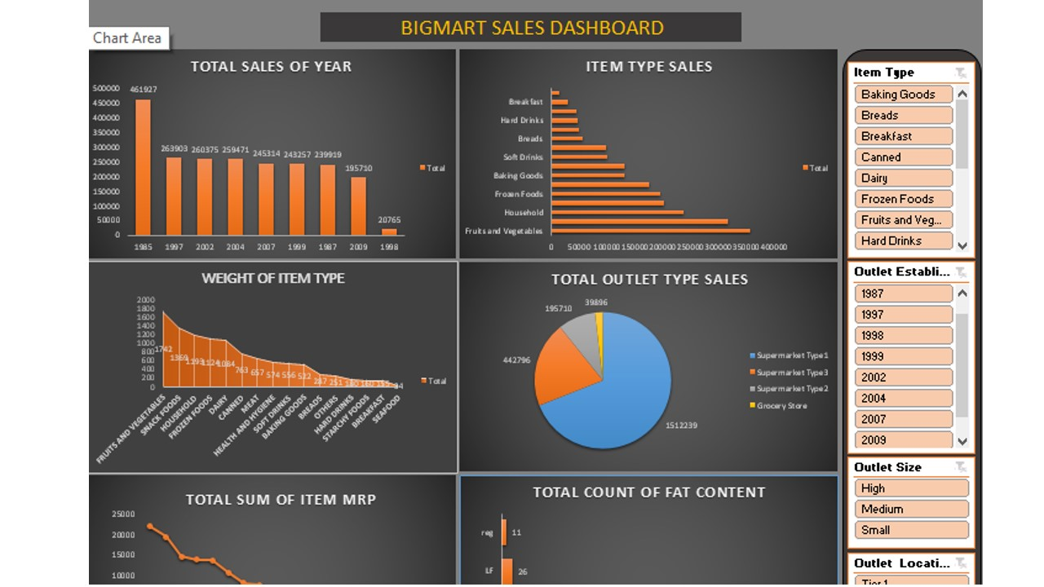

Slide 18
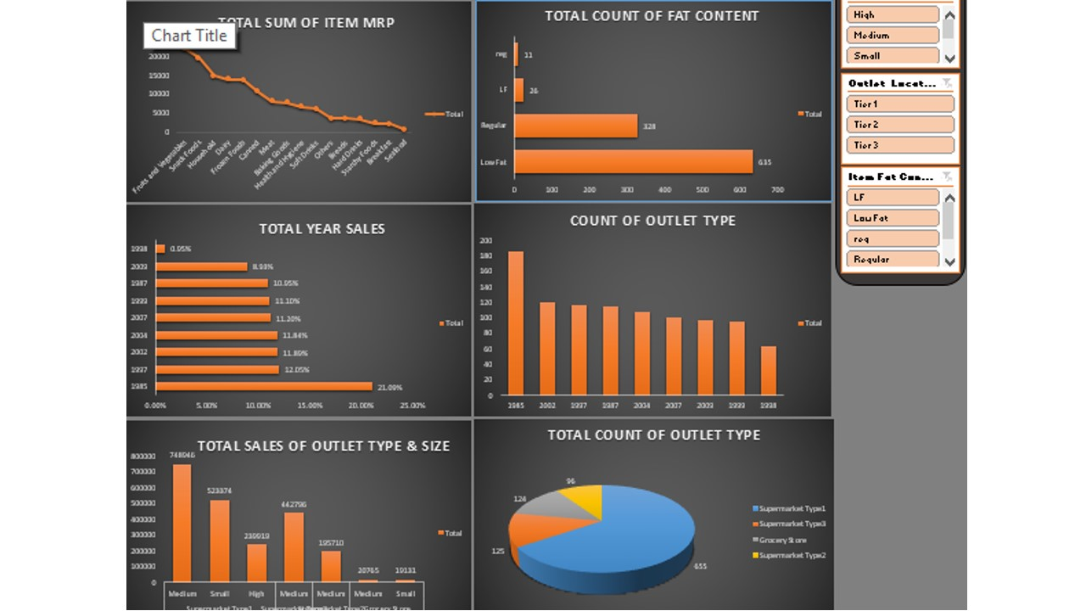

Slide 19
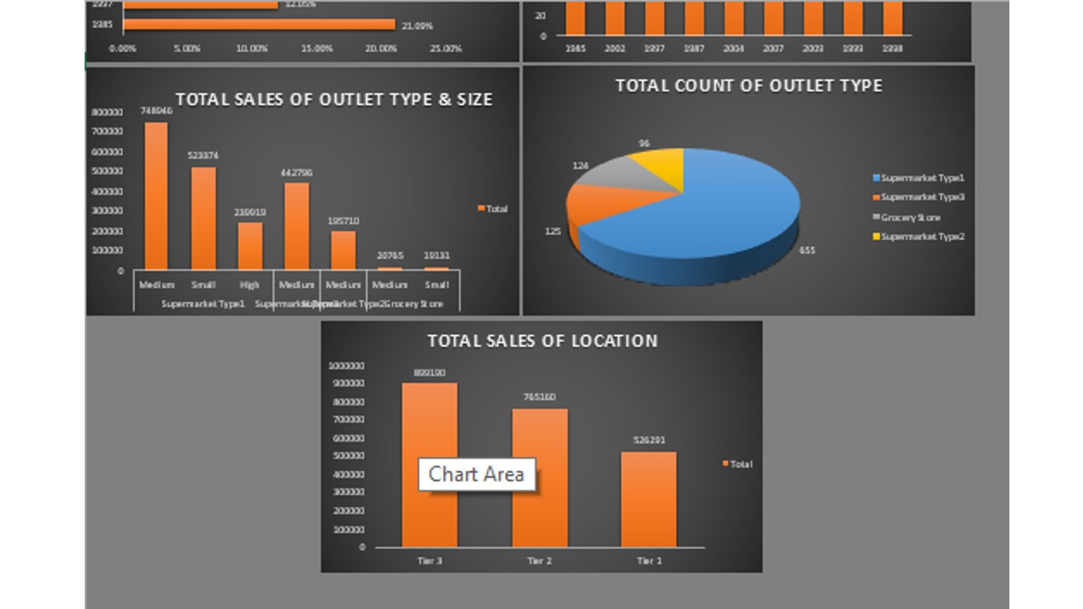

Slide 20
THANK YOU

